Slide 1
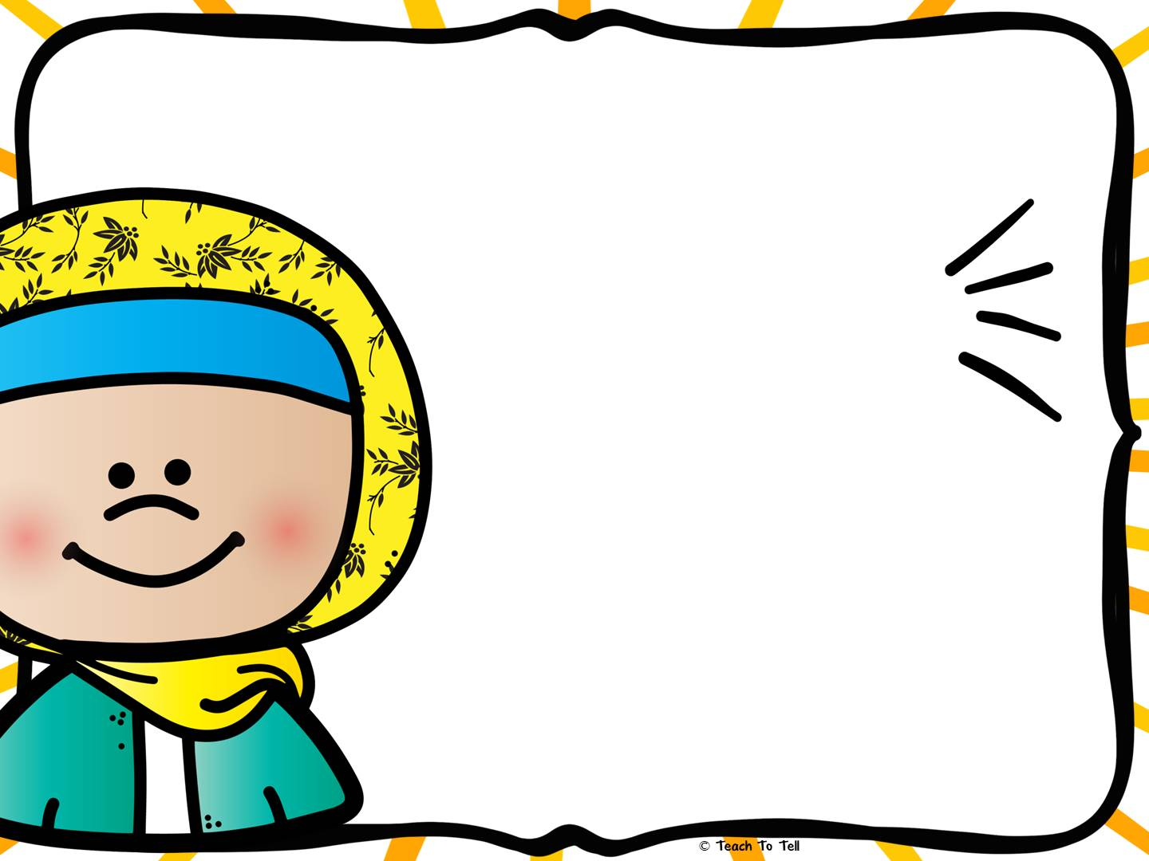

READING STAR
This award is presented to:
Zaara
for displaying great reading skills!
Date
Teacher
Ms. Anayeza
28.1.25

Slide 2
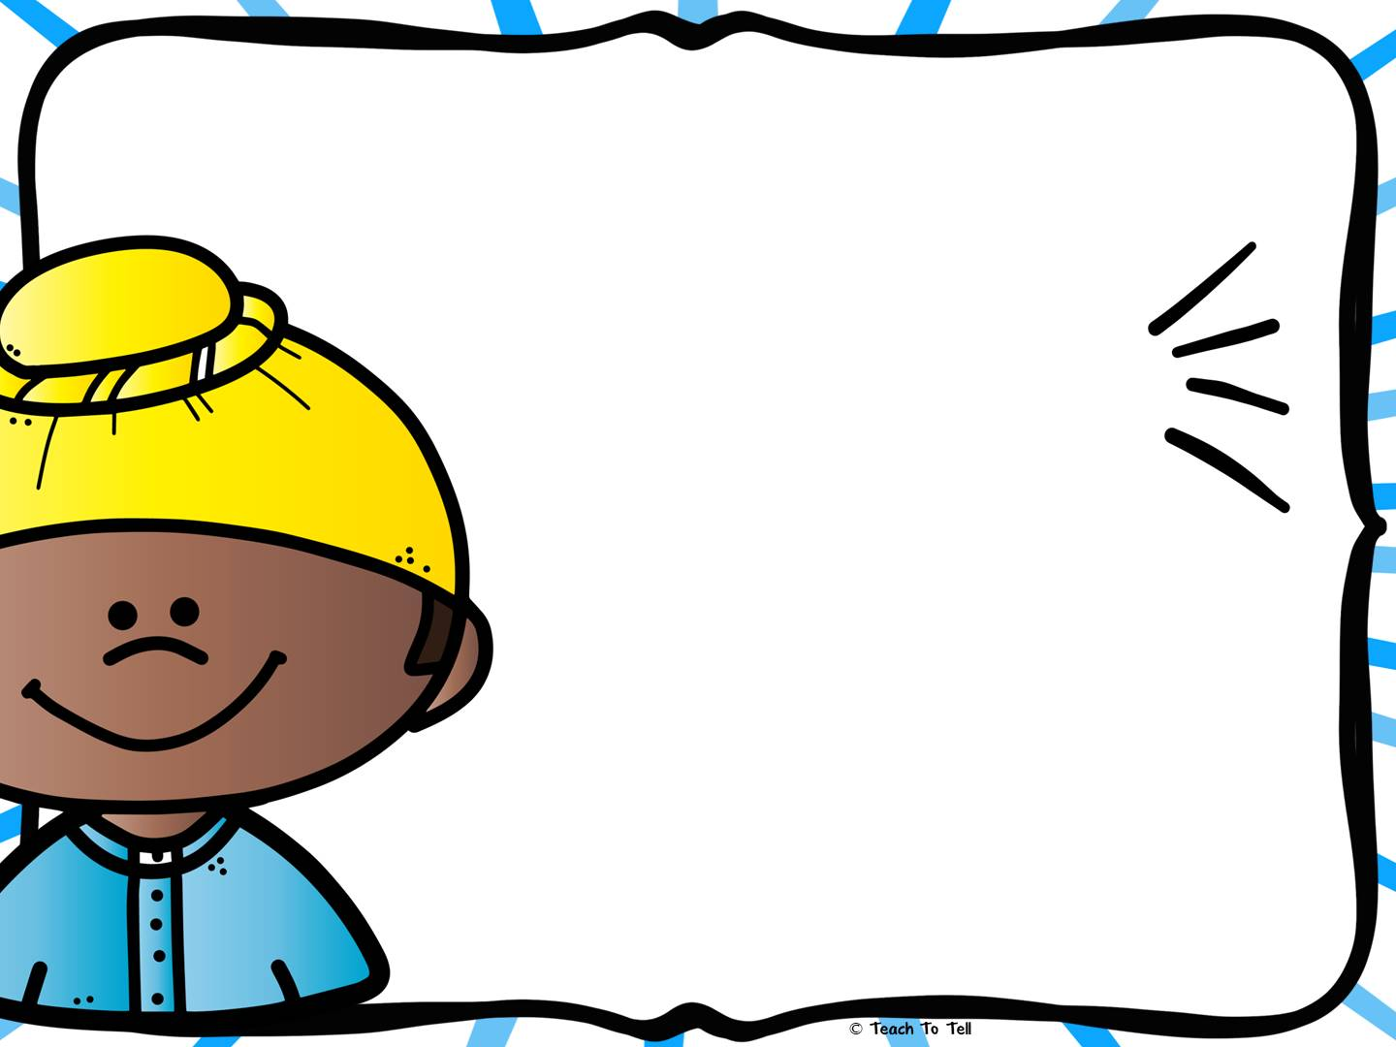
READING STAR
This award is presented to:
Abdullah
for displaying great reading skills!
Teacher
Date
Ms. Anayeza
28.1.25

